Slide 1





Portfolio
IMAGE CLASSIFICATION USING CNN + VGG19
NBA TEAM LOGOS
by:
Bhima Fairul Rifqi & Hendri Agustono

Slide 2






Portfolio
NBA
The National Basketball Association (NBA) is a professional basketball league in North America. As of now, the number of participants in the league is 30 teams. The NBA is one of the major professional sports leagues in the United States and Canada and is considered as the best professional basketball league in the world. The NBA itself is using the iconic silhouette of the late Jerry West as its logo.

Slide 3







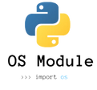



Portfolio
Library Used
1
numpy
6
pillow
2
pandas
7
pathlib
3
tensorflow
8
os
4
sklearn
5
matplotlib

Slide 4
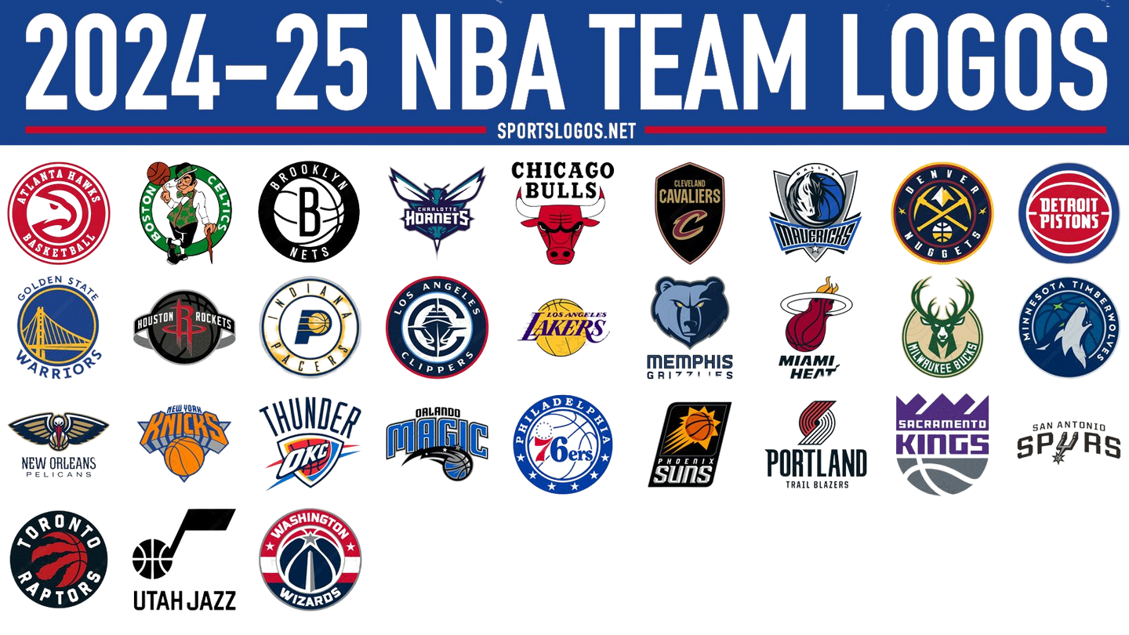


Portfolio
Dataset
30 NBA Teams
600 Images
We used multiple versions of the logo for each team, with each team having 20 images in its set.

Slide 5


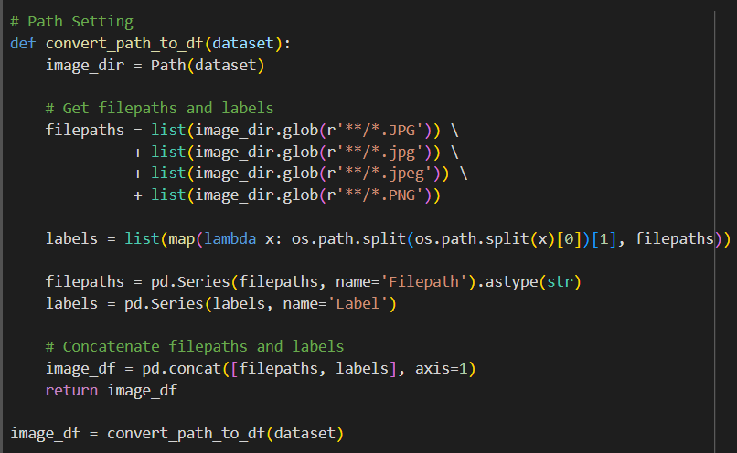

Portfolio
Path Setting
The code beside is intended to convert the directory of the logo images into a dataframe containing the location of the image files and its labels.

Slide 6
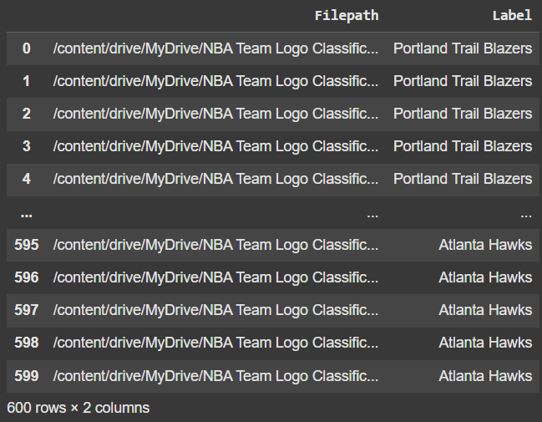
Portfolio
Path Setting
The image beside is the result of path setting, containing 600 images and 30 different labels.

Slide 7
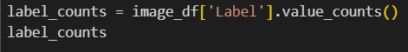
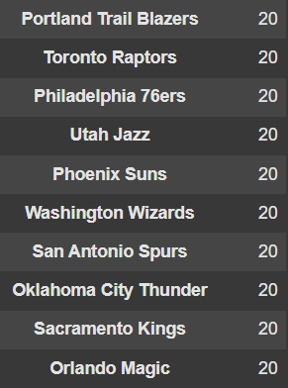
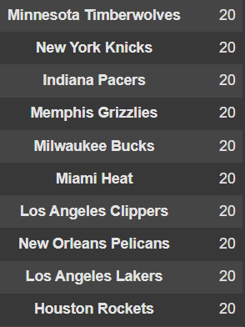
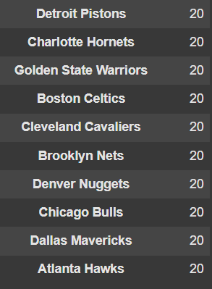
Portfolio
Labels and Its Number of Data

Slide 8
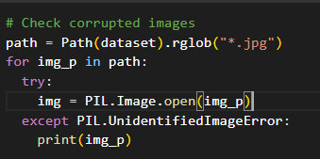
Portfolio
Check Corrupted Images from Dataset
Checks if there is any images is corrupt or damaged and displays the file name when there is corrupt data.
Result: No corrupt data

Slide 9

Portfolio
Data
Preprocessing
01
Splitting Data ( 80% Train & 20% Testing )
Splitting the dataset into two segments for training and testing.
02
Seperate data for train_generator and test_generator with VGG19 preprocess input
Seperate data train and test into two different generators.
03
Create augmented pipeline with preprocessing layers
Create augmented pipeline for the inputs for model architecture.

Slide 10
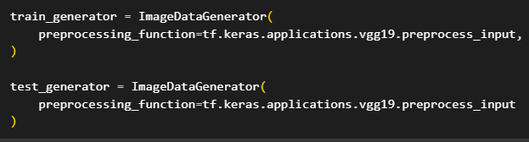
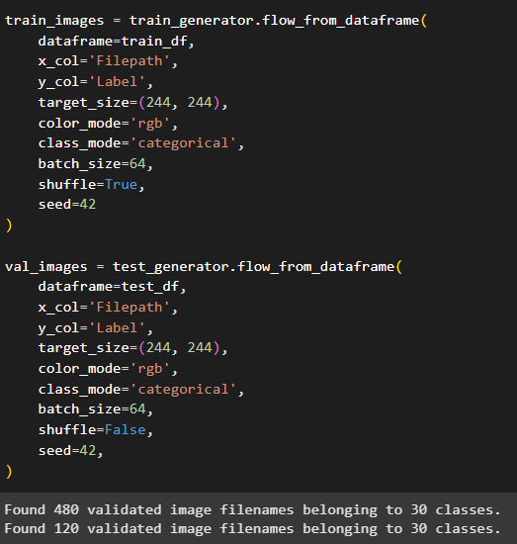
Portfolio
Splitting Data
Splitting dataset to 80% training and 20% for testing.
Seperate Data
This setup prepares data for feeding into a model, separating data into training and testing sets and applying preprocessing specific to the VGG19 network.

Slide 11
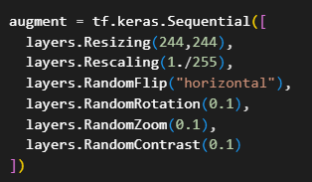
Portfolio
Create Augmented Pipeline
This code make pipeline that chains together with several image transformations to be applied sequentially. First, images are resized to 244x244 pixels. Then, pixel values are rescaled to the range [0, 1] by dividing by 255. Data augmentation is then applied with random horizontal flips, rotations up to 0.1 radians, zooms with a factor of 0.1, and contrast adjustments also with a factor of 0.1. This augment sequence used to increase training data diversity and improve model robustness.

Slide 12
Portfolio
01
Load Pretrain Model
Model
Training
Initiating the VGG19 pretrained model.
02
Initiate Callbacks
IInitialise callbacks required for training models that is early stopping and reduce learning rate.
03
Create Model Architecture
Defining the architecture of a new model from the pretrained VGG19 layers and new layers defined.
04
Compile The Model
Compiling the final model.

Slide 13
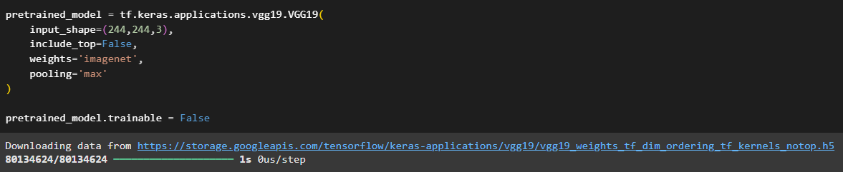
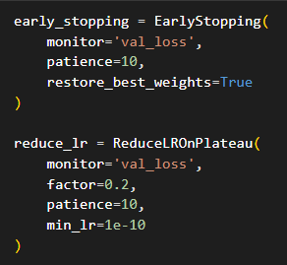
Portfolio
Load Pretrain Model
This code loads a pre-trained VGG19 model from Keras Applications. It specifies an input shape of 244x244 pixels with 3 color channels, doesn't include the top classification layers (include_top=False), uses 'imagenet' weights, and employs max pooling.
Initiate Callbacks
This code initializes two Keras callbacks: EarlyStopping and ReduceLROnPlateau. EarlyStopping monitors the validation loss (val_loss) and stops training if it doesn't improve for 10 epochs (patience=10), restoring the best weights found. ReduceLROnPlateau also monitors val_loss and reduces the learning rate by a factor of 0.2 if the loss plateaus for 10 epochs, with a minimum learning rate of 1e-10. These callbacks help prevent overfitting and fine-tune the learning process for optimal performance.

Slide 14
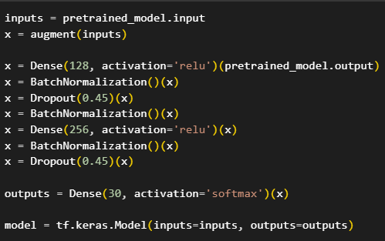
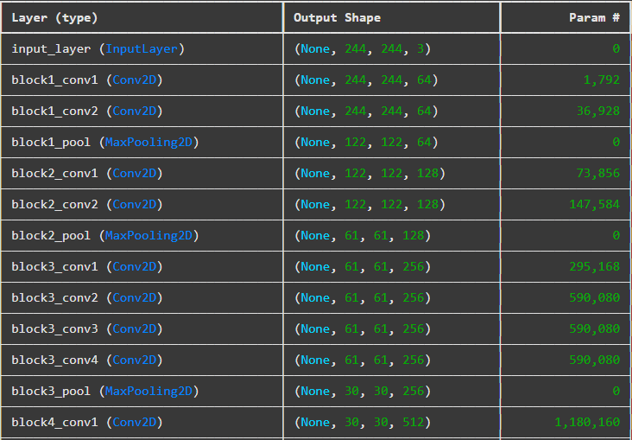
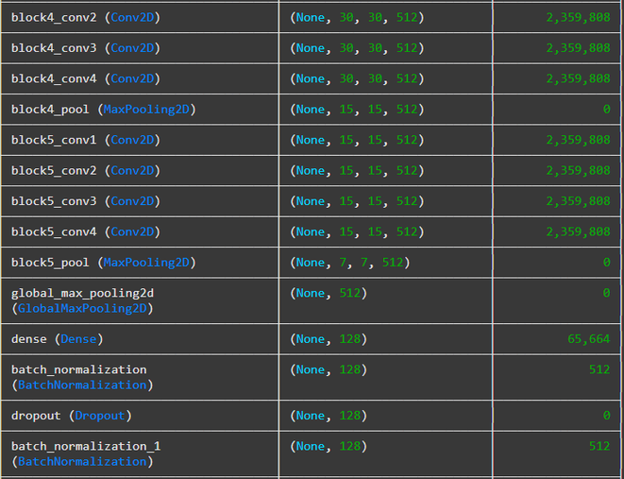
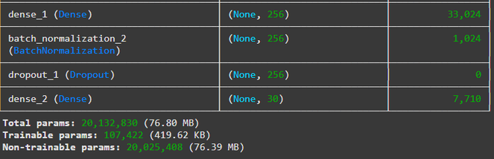
Portfolio
Create Model Architecture
This code constructs a Keras model using a pre-trained model as a base. The input is passed through the pre-trained model and an augmentation layer. The output of the pre-trained model then feeds into two dense layers (128 and 256 units) with ReLU activation, each followed by batch normalization and dropout. Finally, a dense output layer with softmax activation and 30 units is added for classification.
The final total parameters owned by the model is 20 million with a size of 76.80 mega bytes.

Slide 15
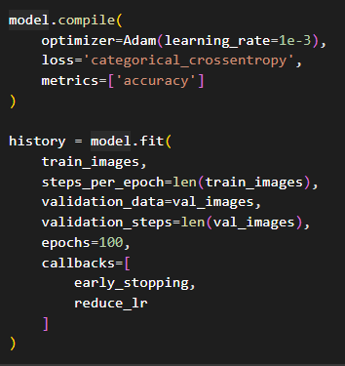
Portfolio
Compile The Model
This code compiles and trains a Keras model. The model.compile function configures the model for training using the Adam optimizer with a learning rate of 1e-3, categorical cross-entropy loss , and accuracy as the evaluation metric. The model.fit function then trains the model on train_images and validates it on val_images. It runs for a maximum of 100 epochs and utilizes the previously defined early_stopping and reduce_lr callbacks to optimize the training process and prevent overfitting.

Slide 16

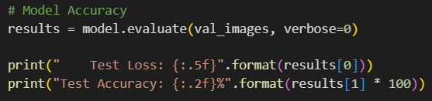
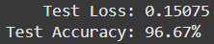

Portfolio
Model Evaluation
Input
Output
Explanation
The test results show strong model performance, with a test loss of 0.15075 and a test accuracy of 96.67%. A low test loss indicates the model's predictions are close to the actual values, while the high accuracy means it correctly classified nearly 97% of the test data, demonstrating the model's effectiveness.

Slide 17
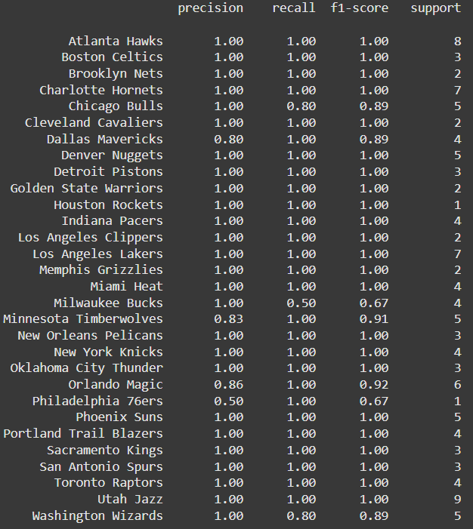
Portfolio
Classification Report

Slide 18
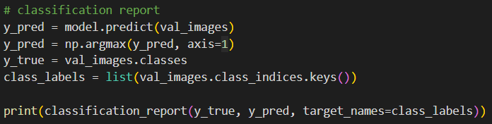
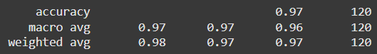
Portfolio
Classification Report
Input
Output
Explanation
The classification report shows strong model performance, with an accuracy of 97%, indicating correct predictions for 97% of the 120 samples. The macro average (precision, recall at 0.97, F1 at 0.96) suggests consistent performance across all classes. The weighted average (precision at 0.98, recall at 0.97, F1 at 0.97) adjusts for class imbalances, highlighting the model's overall effectiveness.

Slide 19
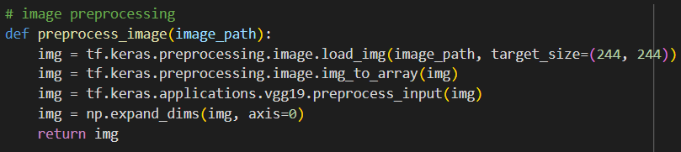


Portfolio
Image Preprocessing
The preprocess_image(image_path) function prepares an image from user input to fit in model predict. first, loads the image from the given path and resizes it to 244x244 pixels, which is the size the model expects. Then, it converts the image into a VGG19 preprocessing input format. The function also adds an extra dimension to the image to make it look like a batch of images, even though it's just one. Finally, it returns the processed image, ready for the model to make predictions.

Slide 20
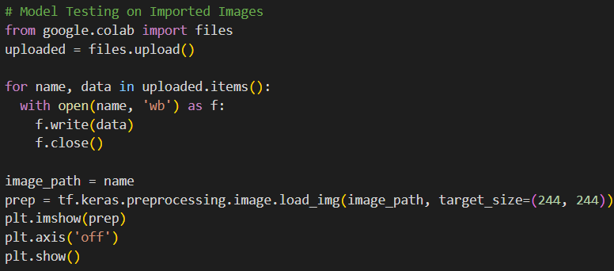

Portfolio
Model Testing
To check if the model is classifying images correctly, we are going to test it on some images imported from the local device into the Google Collab platform.

Slide 21



Portfolio
1
2
3
Model
Testing
FYI: The three images above show the logos of the Boston Celtics (left), San Antonio Spurs (middle), and Denver Nuggets (right).
We will test the model to see if the output matches our expectations.
Expected results: 'Boston Celtics' for 'boston.jpg' (left image), 'San Antonio Spurs' for 'sas.jpg' (middle image), and 'Denver Nuggets' for 'den.jpg' (right image).

Slide 22
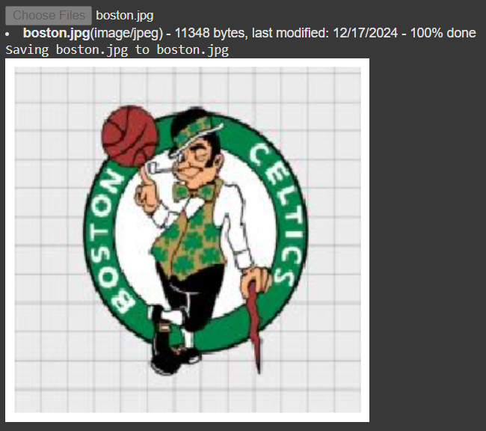
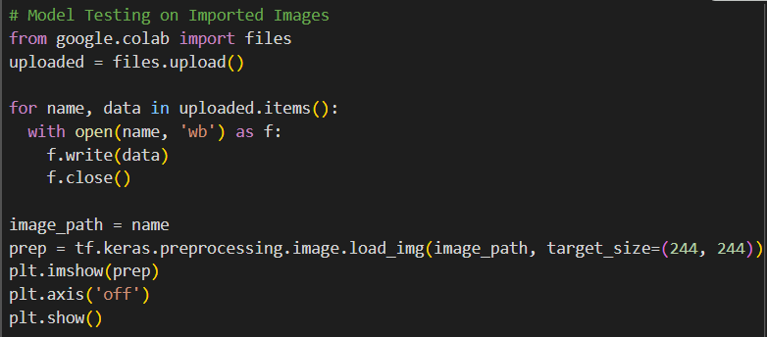

Portfolio
Model Testing #1

Slide 23
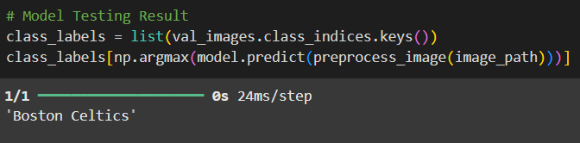
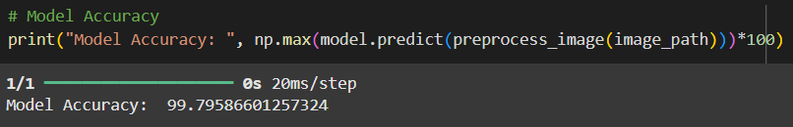
Portfolio
Model Testing #1: Result
Explanation
The pictures beside show that the result is the logo of the Boston Celtics, which matches our expectations. The 'Model Accuracy: 99.796' indicates that the model correctly predicted about 99.8% of the tested image, demonstrating excellent performance and high accuracy in classification.

Slide 24
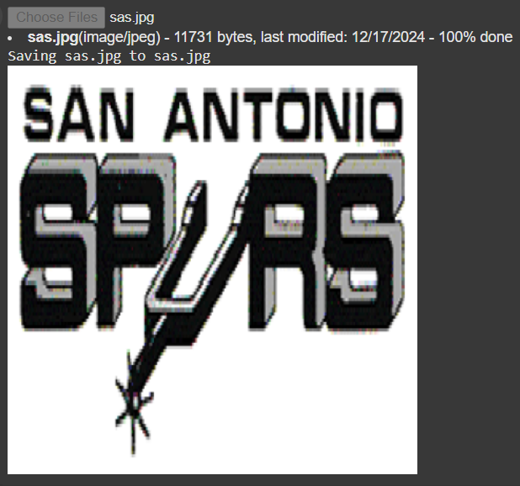
Portfolio
Model Testing #2

Slide 25
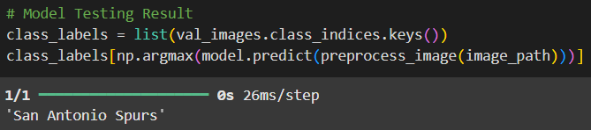
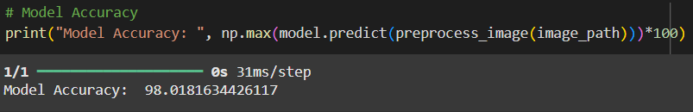
Portfolio
Model Testing #2: Result
Explanation
The pictures beside show that the result is the logo of the San Antonio Spurs, which matches our expectations. The 'Model Accuracy: 98.018' indicates that the model correctly predicted about 98% of the tested image, demonstrating excellent performance and high accuracy in classification.

Slide 26
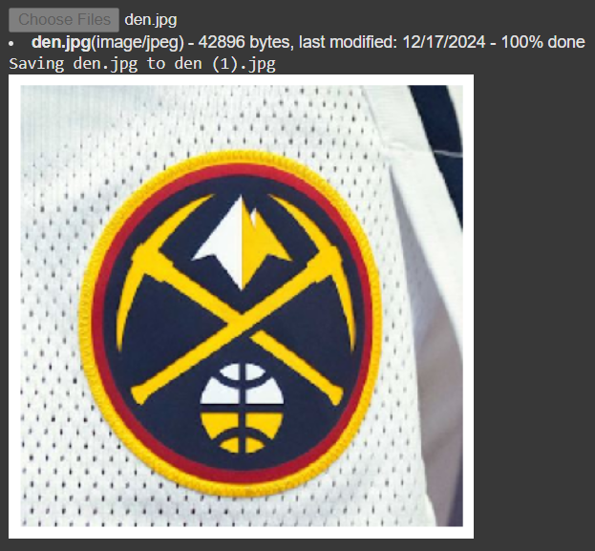
Portfolio
Model Testing #3

Slide 27
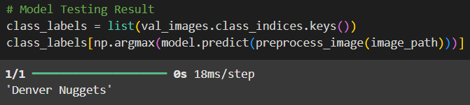
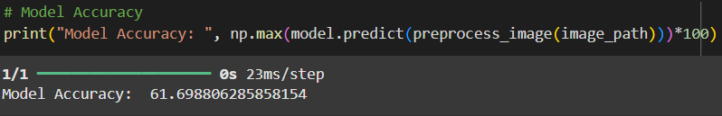
Portfolio
Model Testing #3: Result
Explanation
The pictures beside show that the result is the logo of the Denver Nuggets , which matches our expectations. The 'Model Accuracy: 61.699' indicates that the model correctly predicted about 61.7% of the tested image, demonstrating good performance and good accuracy in classification.

Slide 28
Portfolio
IMAGE CLASSIFICATION USING CNN + VGG19
NBA TEAM LOGOS
Thank You
Thank you for your attention! We look forward to collaborating.
Please feel free to reach out if you have any questions or recommendations.
Bhima Fairul Rifqi
fairulrifqi962@gmail.com
linkedin.com/in/fairulrifqi962
Hendri Agustono h1091221058@student.untan.ac.id linkedin.com/in/hendri-agustono

